Slide 1

LangChain for AI Agents

Slide 2
What to expect ?
What is LangChain ?
Why LangChain ?
Common Terminologies
Prompt
Prompt Template
Parser
Moderation
Inference
What is a Chain ?
LangChain vs LangGraph vs LangSmith/LangFuse vs LangFlow
Understanding LangGraph
State
Nodes
Edge
Conditional Edges
What is a tool ?
How to build a tool ?
Custom script
API call
Web Search
Vector-DB Retriever
Tool Integration with LLM
ReAct Agent
Supervisor – Assistant set up of Agents

Slide 3
LangChain
Simplifies the process of building applications using LLMs
Open source framework
Building chains
Add a layer of abstraction
Developer friendly
Easy to scale
Reduce dependency on any specific framework

Slide 4
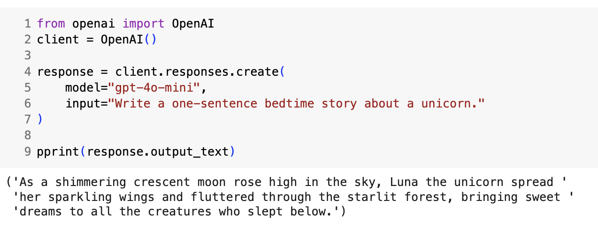
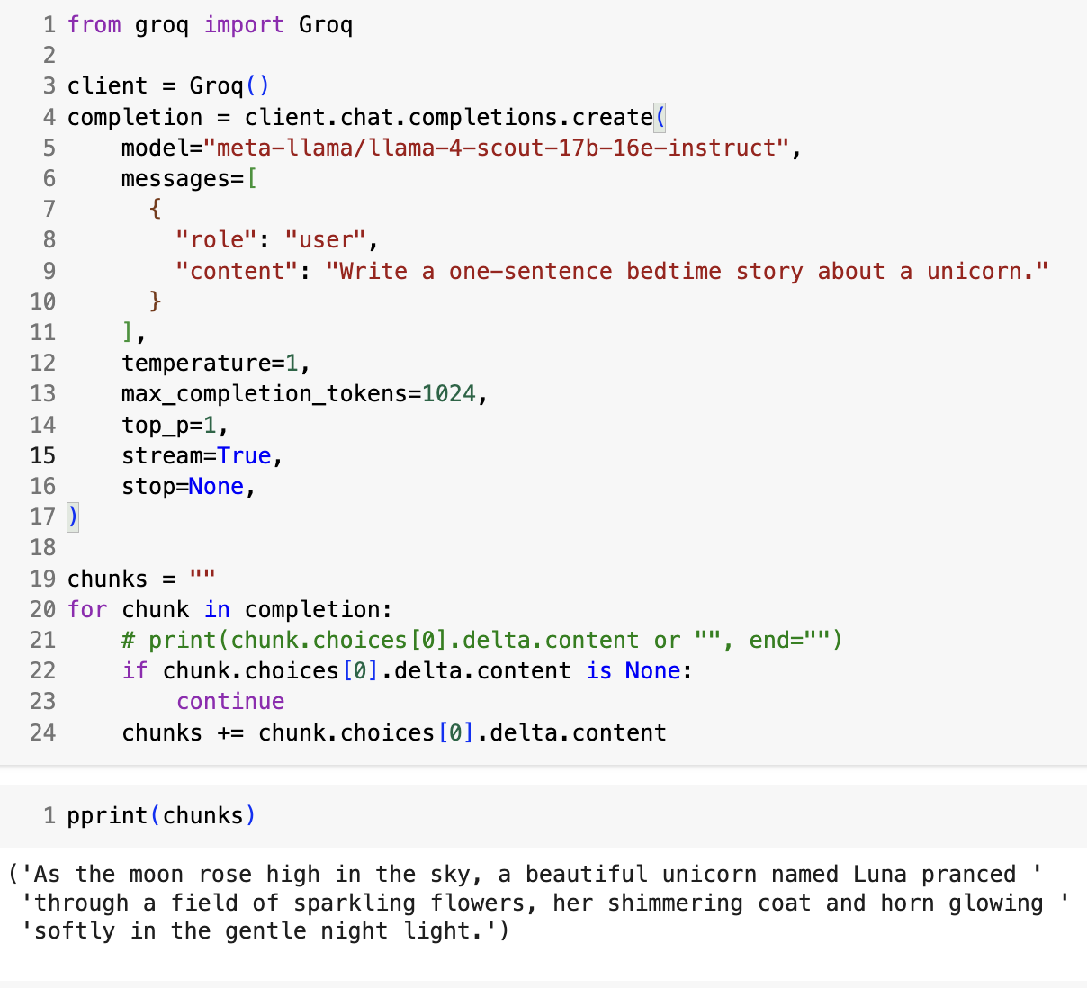
Model Inferencing without LangChain
OpenAI Model Inferencing
OpenAI Model Inferencing

Slide 5
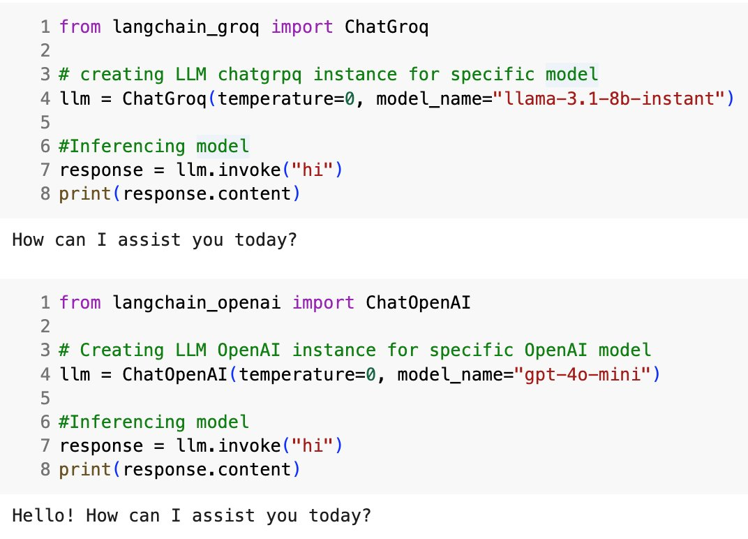
Model Inferencing with LangChain

Slide 6
Prompt and Templates:
Prompt:
input provided to the model to generate a specific output.
Can include question, instruction, context, examples, etc.
Structure of prompt is very important
Templates:
Standard prompt with placeholders that can be updated on the fly
Makes the prompt more dynamic
Similar to f-string in python
Types:
Prompt Template
Chat Prompt template
Etc.

Slide 7
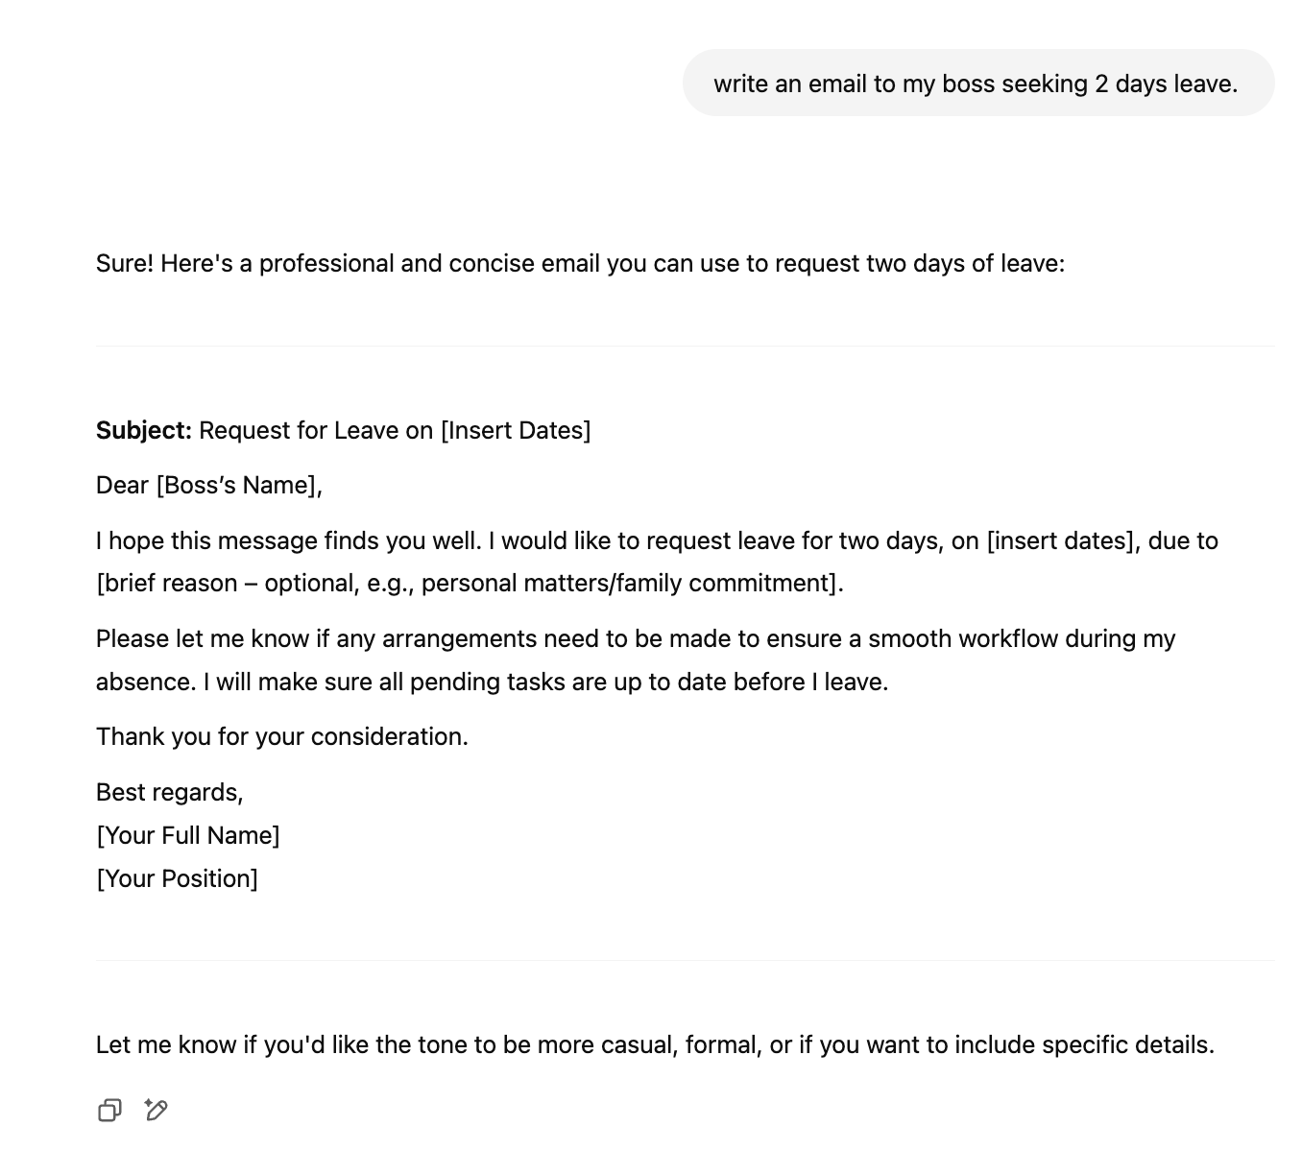
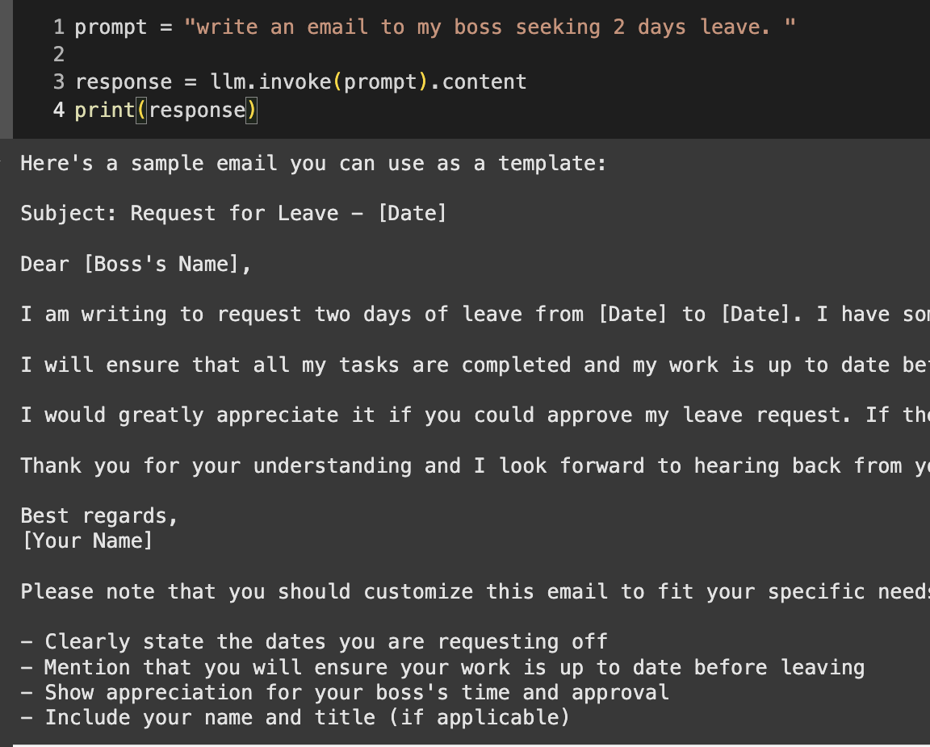
Parser
Data extraction tool that extract the relevant information from any input content

Slide 8
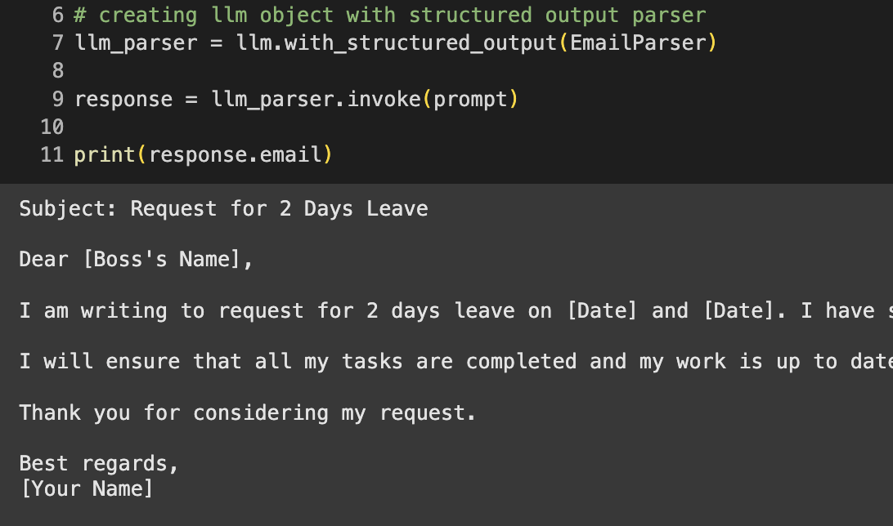
Why Parser?
Clean response to be consumed directly
Easy to integrate

Slide 9
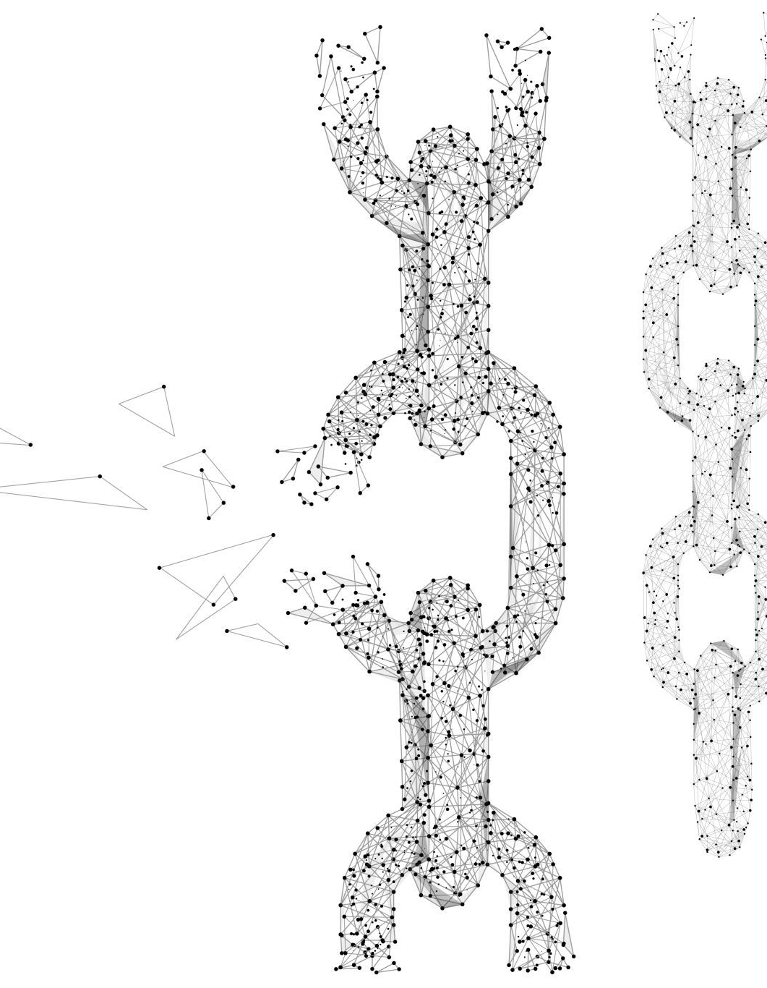
Chain
A sequence of call to different component like language model, data preprocessing steps, external tools, executed in a specific order
Like a pipeline where output of one step becomes the input to the next step
Fundamental building block of LangChain
Eg. Chain: Prompt – LLM – Parser

Slide 10
LangGraph
Framework build over LangChain that allows developers to create complex, stateful, multi-agent applications using LLMs.
User Graph based architecture : Directed Acyclic Graphs (DAG)
Small chains stitched together to form a complex graph
Enables Multi-Agents applications
Allows agents to maintain & update their memory (state) on the fly
Enables observability when integrated with LangSmith or LangFuse like tools
Scalability
Doc link

Slide 11
Common Terminologies:
State
Nodes
Edges
Conditional Edges
START , END

Slide 12

Questions ?

